Slide 1
Roundtable Presentation
Kyle Su

Slide 2
Project Ideas: 1. Sea Movement – Interactive Narrative 2. Ball Game – High Score 3. Cherry Blossom Tree – Choose your own adventure

Slide 3
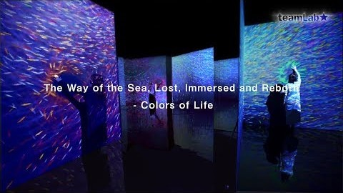
Sea Movement
Dan Shiffman – Flocking birds
https://processing.org/examples/flocking.html

Slide 4
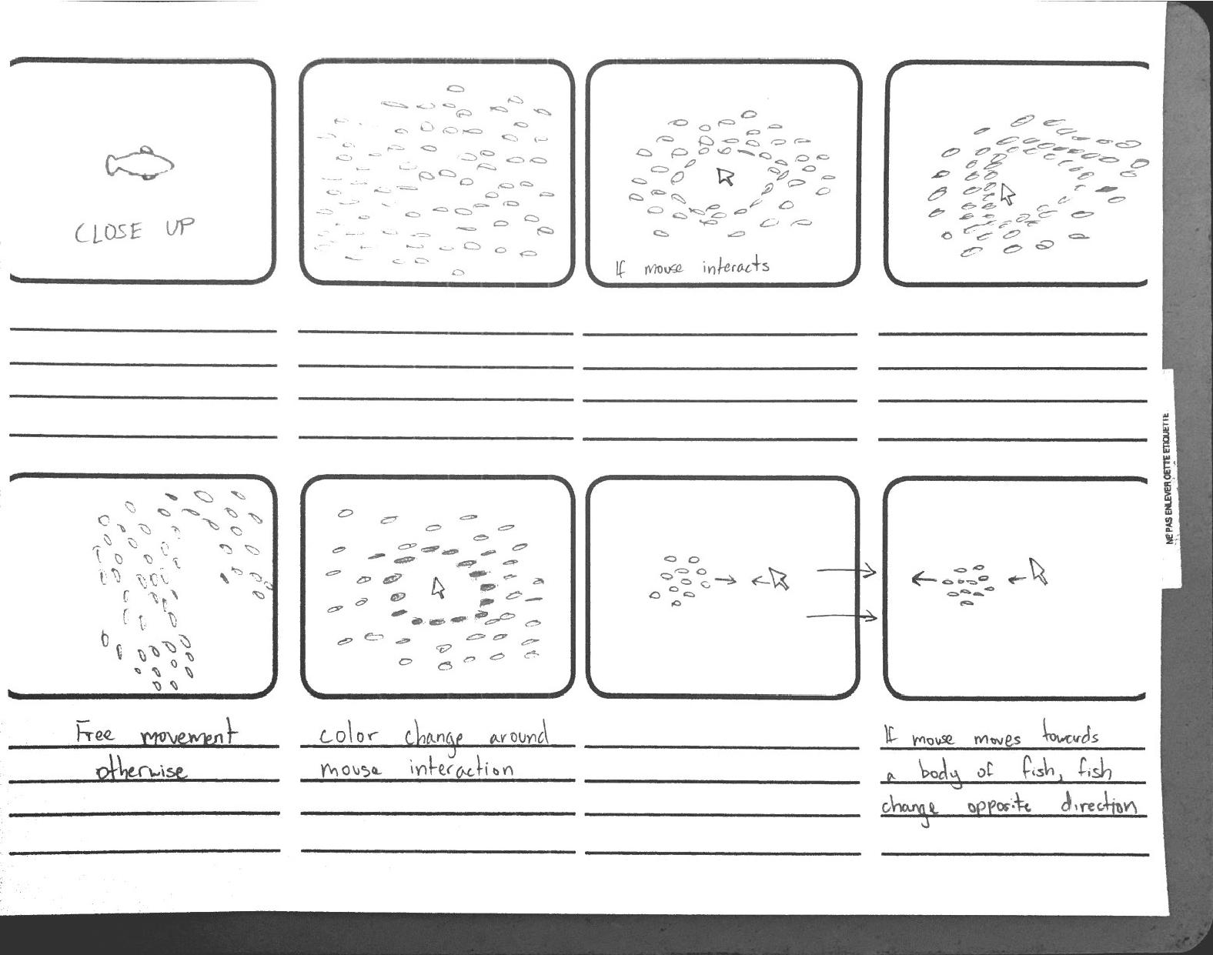

Slide 5
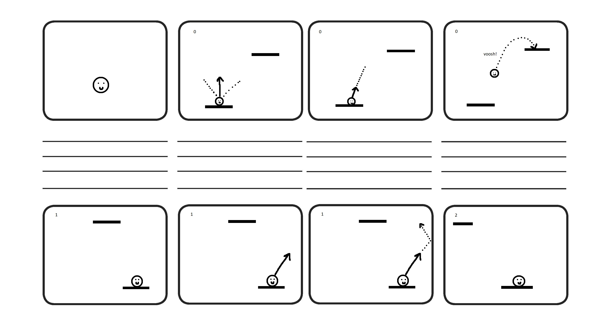
Ball Game

Slide 6
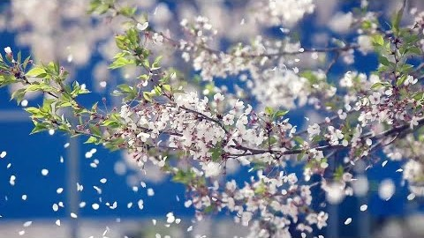
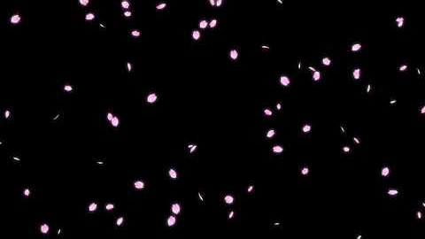
Cherry Blossom Tree
Dan Shiffman – Fractal Tree
https://www.youtube.com/watch?v=fcdNSZ9IzJM
Cherry blossom petals fall at a speed of 5 centimeters per second.

Slide 7
